Slide 1
Big Mountain Resort

Slide 2
Problem Statement
What opportunities exist at Big Mountain Resort to recoup increased operating costs of $1,540,000 to maintain a profit margin of at least 9.2% for this fiscal year?
H
1
Context
4
Constraints within solution space
Big Mountain Resort recently installed a new chair lift to even out the distribution of its visitors. The new lift will increase operating costs by $1.54 million. Management is seeking recommendations for this year to recoup the new costs to maintain its current profit margin of 9.2%.
In light of the recent increase in operating expenses, management may hesitate regarding any recommendations that increase costs (even if profitable overall)
2
Criteria for success
5
Stakeholders to provide key insight
Specific recommendations to recoup costs will be submitted.
Projections for this year’s annual revenue based on these recommendations will recoup the new lift costs to maintain a projected revenue profit margin of at least 9.2%. The implementation timetable for recommendations will be dependent on the nature of each.
Big Mountain Resort Executive Team
Jimmy Blackburn, Director of Operations
Alesha Eisen, Database Manager
6
Key data sources
3
Scope of solution space
CSV File -- contains industry-wide data; the columns re: Projected Days Open and Adult Weekend Ticket Price may be especially helpful.
Solutions will be limited to recommendations on how to recoup costs
H
D
E
I
P

Slide 3
Recommendation and Key Findings
The net results of our modeling were that, based on the characteristics of Big Mountain Resort in comparison with many other ski resorts in the industry, Big Mountain could slightly increase their Adult Weekend ticket price from $81 to $82.75. Modeling for the adult weekday price also suggests a small price increase. So, if Big Mountain would like to keep the price uniform between weekday and weekend as before, my model recommends a price increase to $83.
Current Ticket Price:
$81
Model Recommended Price:
$83

Slide 4
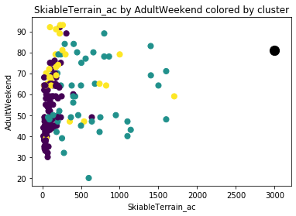
Modeling Results and Analysis (1/3)
A few things distinguish Big Mountain from the other ski resorts, and therefore warrant the recommended price increase. Within our condensed data set, Big Mountain has far and away the most acres of skiable terrain.

Slide 5
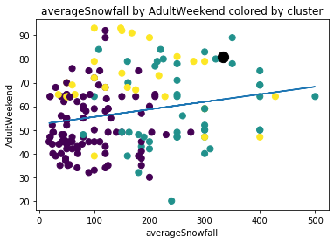
Modeling Results and Analysis (2/3)
Big Mountain also has more average snowfall than the majority other resorts. This feature has a positive correlation with Adult Weekend price within our data set.

Slide 6
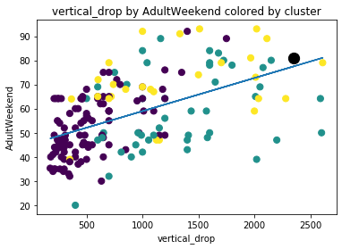
Modeling Results and Analysis (3/3)
The size of Big Mountain Resort’s largest vertical drop separates it from the vast majority of other ski resorts in our condensed data set. Like average snowfall, this is a feature that correlates with price for ski resorts within our data set.

Slide 7
Summary and Conclusion
The original prompt for this project was to maintain the profit margin of 9.2%. Based on the data provided, I can make a recommendation (namely, slightly increasing ticket prices) that should increase revenue for the upcoming fiscal year. However, we would need additional internal financial data to draw firm conclusions as to whether these changes in ticket price would sufficiently recoup the added costs of the new chairlift to maintain the stated profit margin.

